Slide 1
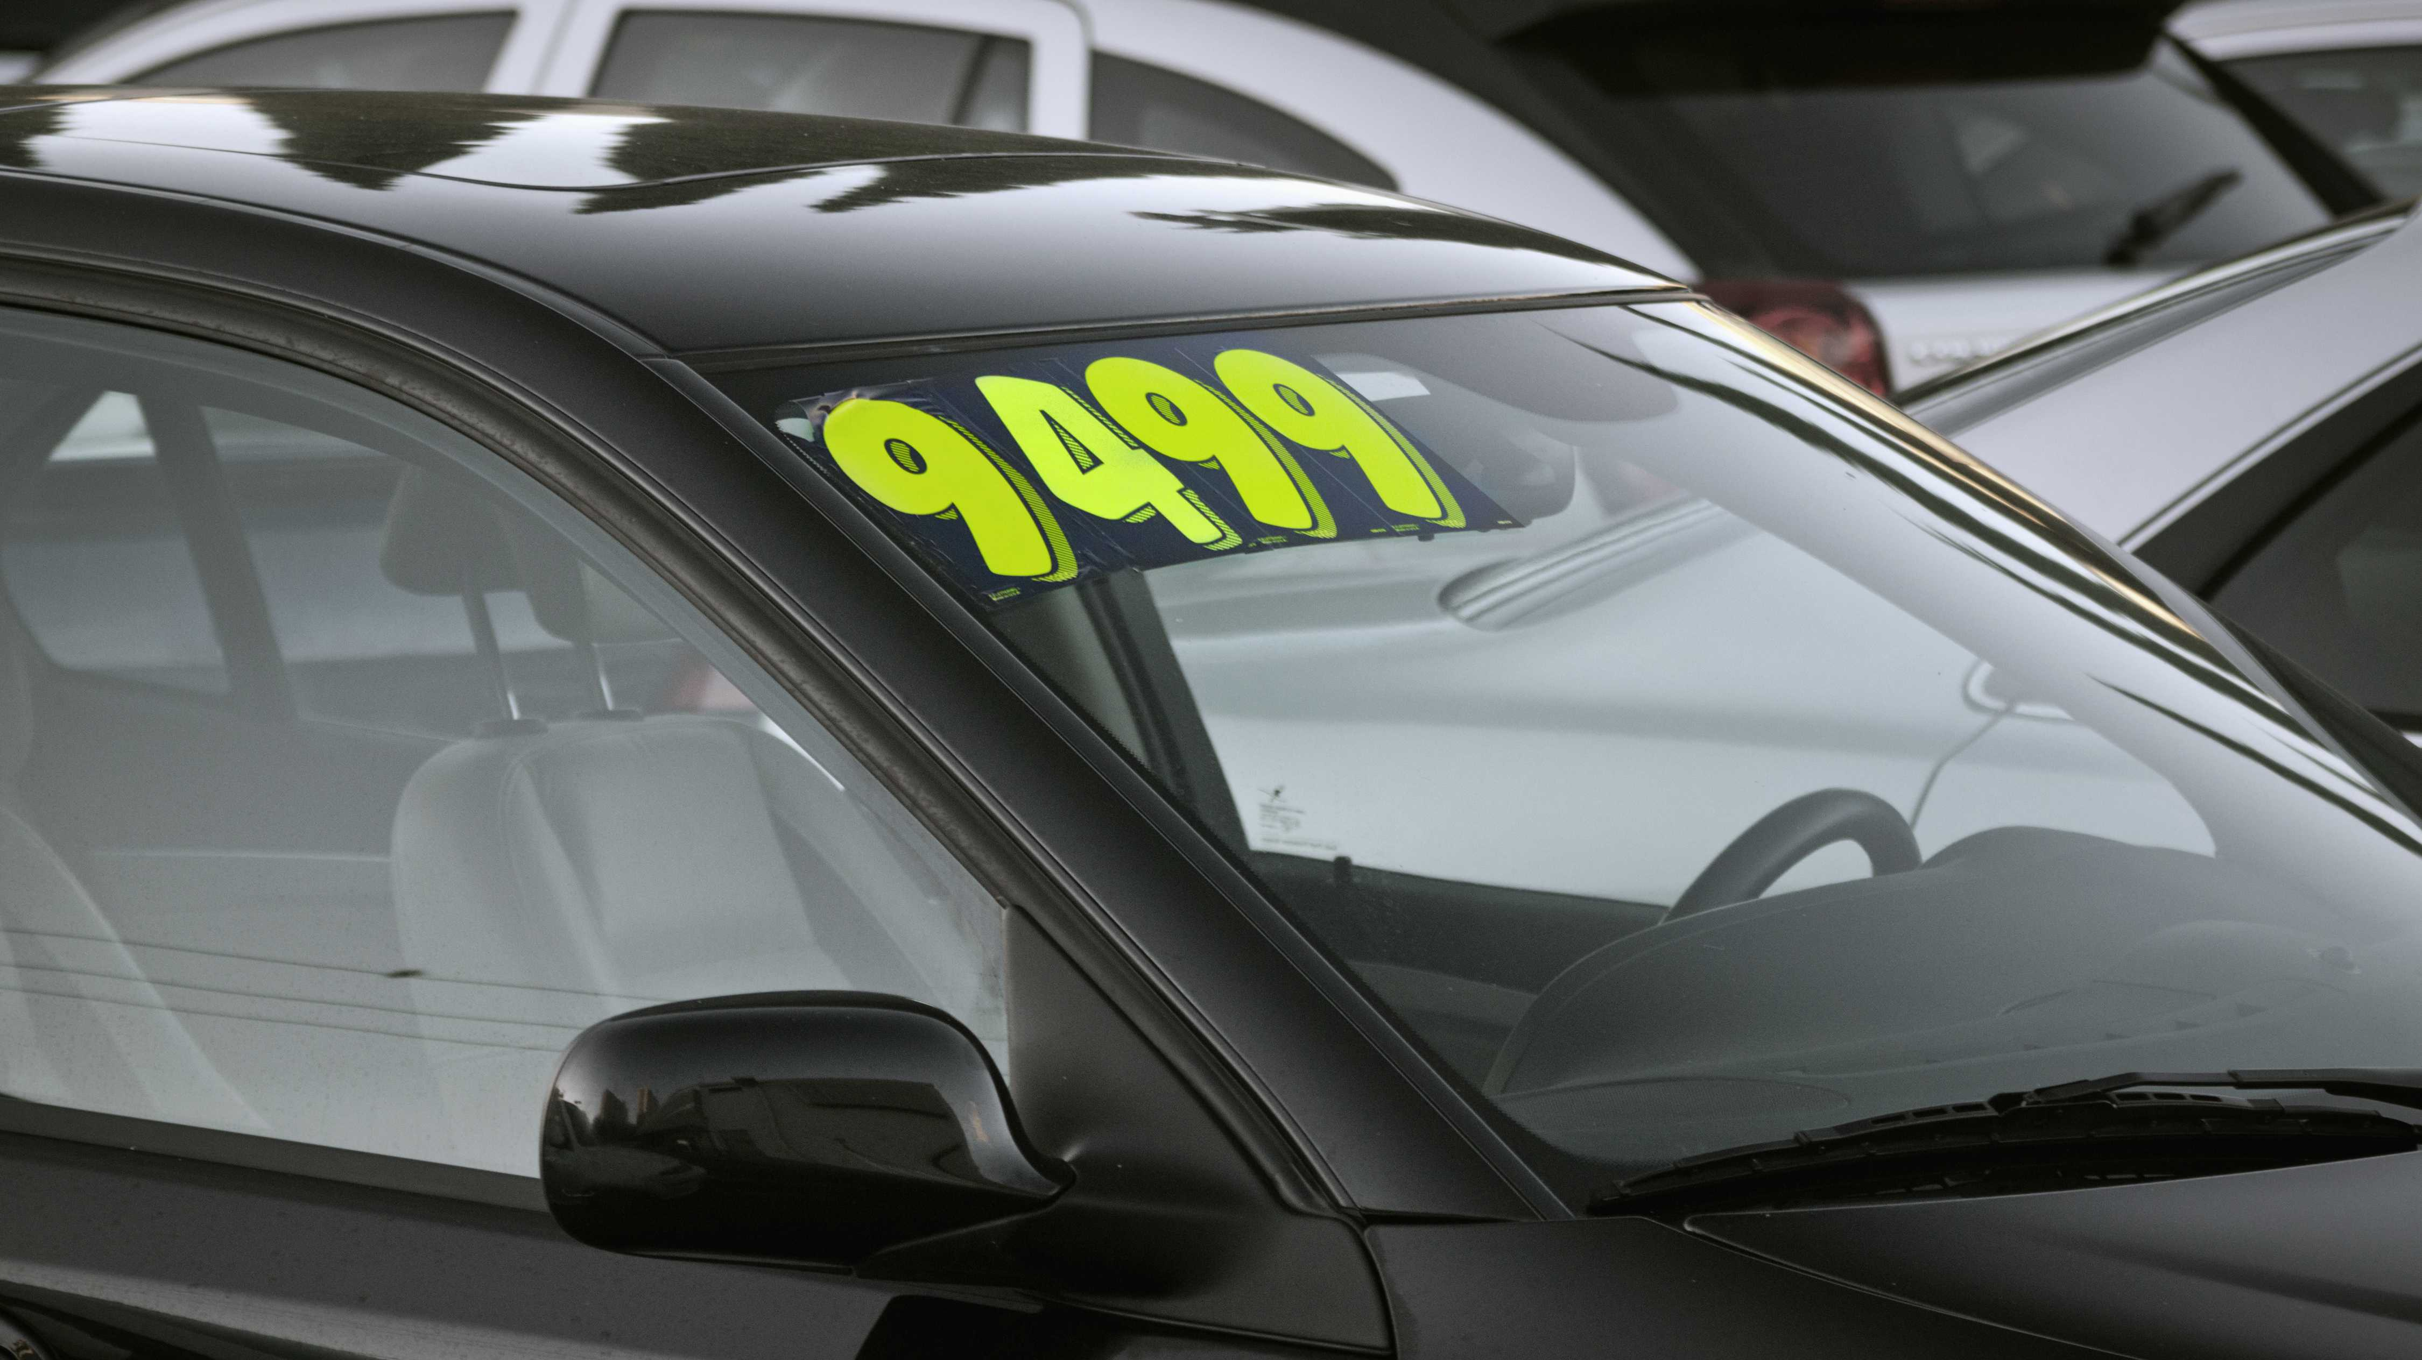
Cars Data Set
Team Name – Velocity
Team Members – Daniel, Alston, Eugene
This Photo by Unknown Author is licensed under CC BY-NC-ND

Slide 2

Introduction
Welcome, everyone. Today, We’re excited to present our analysis of the “CarsData” dataset. Our goal is to dive into this dataset, uncover insights, and share our findings with you. Throughout this presentation, we’ll provide an overview of the dataset, address research questions, showcase data visualization, explore SQL queries, and highlight key findings.
Let's dive in and explore the amazing world of automotive data together.
Notes:
Eugene

Slide 3
Dataset Description
Overview
Comprehensive vehicle information database.
Includes make, model, year, fuel type, transmission, price
Sourced from Kaggle, URL - Vehicle Dataset from Kaggle
Reliability
Data reliability hinges on Kaggle’s credibility
Acknowledges potential issues: incomplete lists, outdates data
Emphasizes thorough verification and cleaning
Data Cleaning
Addressed missing, duplicate, and inconsistent data
Improved data quality for meaningful analysis
Steps included handling missing data, removing duplicates, standardizing formats
Notes:
Eugene
Overview - The data base contains comprehensive information on different vehicle types, including their make, model, year of manufacture, fuel type, transmission type, selling price, etc. It comes from Kaggle, an established website for the all the dataset. URL - Vehicle Dataset from Kaggle
Reliability - The reliability of the data depends on various factors such as the credibility of the source (Kaggle), the data collection process, and the extent of data validation. In general, it is considered safe to rely on information from trusted sources such as Kaggle. However, potential problems such as incomplete lists, outdated information or data entry errors need to be acknowledged. Therefore, to ensure the accuracy and reliability of the data sets for analysis it is essential that they be thoroughly verified and cleaned.
Data Cleaning – Some changes made are Handling missing data, Removing duplicates, and standardizing data formats. Data cleaning was intended to improve the quality of data by addressing missing, duplicate and inconsistencies ensuring that subsequent analyses are based on accurate and reliable data in order to provide meaningful information.

Slide 4

Dataset Overview
A complete overview of the car world is presented in an "CarsData" data set, providing a variety of features for each vehicle model. It contains a number of columns that provide important information on the used vehicles included in this data set.
These Columns include:
Notes:
Eugene

Slide 5
Dataset Overview
Make/Model: Represents the brand/model
Price: Indicate the price of each car model.
Year: Denotes the manufacturing year of the car.
Fuel Type: Specifies the type of fuel the car uses. (eg. Gasoline, Electric, E85 Flex Fuel)
Transmission: Type of transmission systems.
State: Indicates the State where the car is located.
InteriorColor: Represents the Interior color of the car.
Used/New: Indicates weather the car is used or new.
SellerType: Indicates the type of seller.
Min MPG: Denotes the min miles per gallon
Max MPG: Maximum max miles per gallon
Drivetrain: Types of drivetrain systems (eg, FWD, RWD, AWD)
This databank provides valuable information on different aspects of cars, such as their specifications, cost and location. It provides a powerful source of information for analyzing and exploring, given the number of entries covering various car models.
Notes:
Daniel

Slide 6
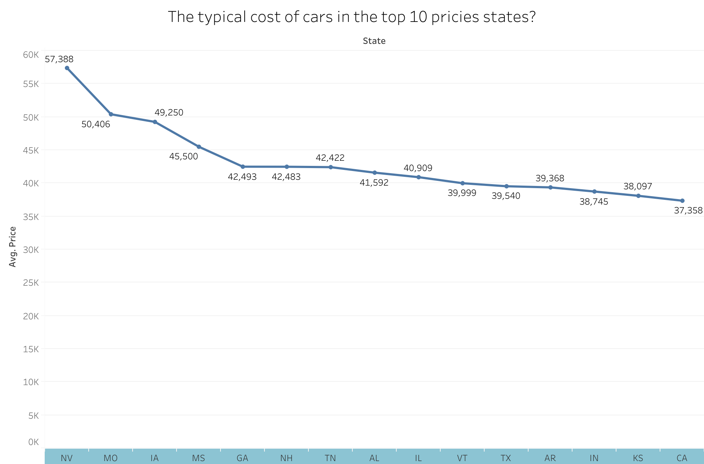
Data Visualizations 1 Line Chart- What are average car prices in the top 15 priciest states?
Created By Tableau
The bar chart provides a comprehensive view of the average distribution of car prices within the top 10 states with the highest prices. By visually comparing the pricing patterns across these regions, it enables the identification of variations in pricing, thereby providing insights into the relative affordability of cars in different areas within the top 10. It's important to note that this chart represents a snapshot of average prices and does not depict pricing trends over a specific period of time.
Notes:
Daniel

Slide 7
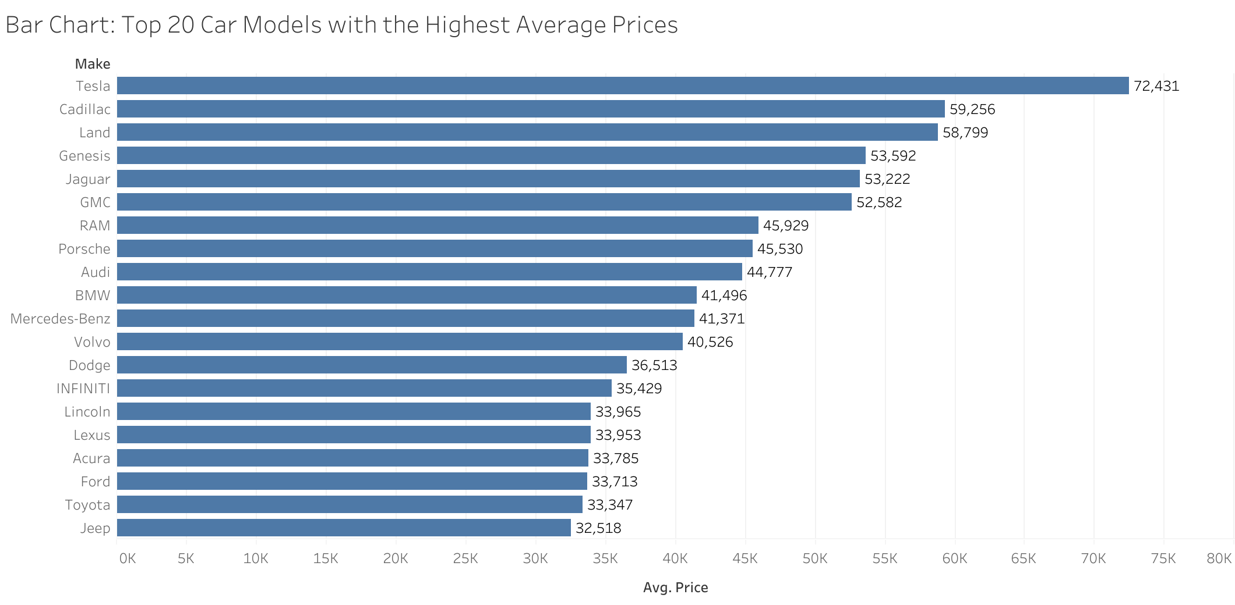
Data Visualizations 2 Bar Chart - Which top 20 Car Models have the highest average price?
Created By Tableau
The bar chart visually represents the average prices of the top 20 car models, offering insights into pricing trends and model popularity. This visualization aids in identifying which car models command higher or lower prices in the market, providing valuable information for consumers and industry stakeholders.
Notes:
Daniel

Slide 8
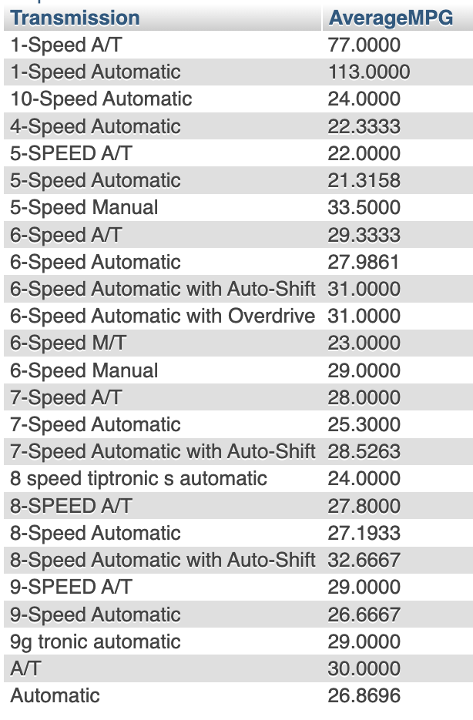
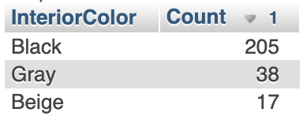
SQL Queries & Results;
1. What is the difference in Average Max mileage (MPG) between used cars with automatic and manual transmissions?
Average Max Mileage Variation by Transmission Type:
SELECT Transmission, AVG(MaxMPG) AS AverageMPG
FROM CarsData1
GROUP By Transmission
2. What are the three most common interior colors in the used cars?
Top 3 Interior Colors Among Used Cars:
SELECT InteriorColor, COUNT(*) AS Count
FROM CarsData1
GROUP BY InteriorColor
ORDER BY Count DESC
Limit 3;
Notes:
Alston

Slide 9
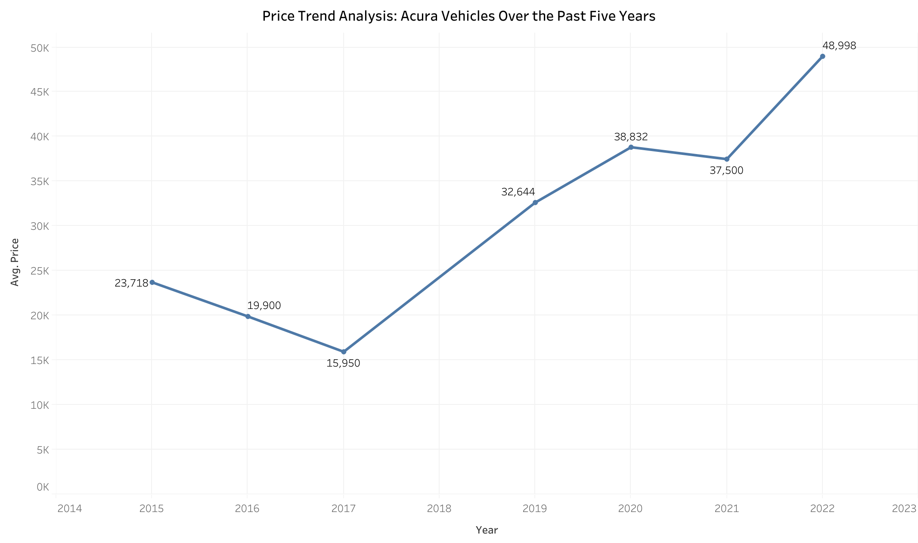
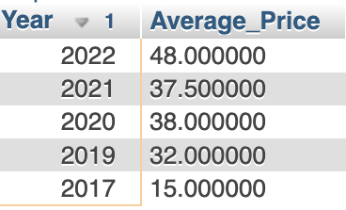
Data Visualizations 3 and SQL Line Chart -How has the price trend evolved for Acura over the past ten years?
Created By Tableau
SELECT Year, AVG(CAST(REPLACE(Price, '$', '') AS DECIMAL(10,2))) AS Average_Price
FROM CarsData1
WHERE Make = 'Acura' AND Year >= YEAR(CURRENT_DATE()) - 7
GROUP BY Year
ORDER BY `CarsData1`.`Year`
This visualization offers a clear depiction of how Acura vehicle prices have changed over time, aiding in understanding pricing patterns and trends.
Notes:
Alston

Slide 10
Additional Research Questions
Which cars of states have sold the most per capita? (find population)
What's the difference in price between cars with automatic and manual transmissions?
How does the price of front-wheel drive vehicles compare to that of all-wheel drive vehicles?
How has the average price of vehicles changed over the years?
Notes:
Alston

Slide 11
Conclusion
What We Learned:
We've been exploring a wide variety of used car data, discovering insights into their features, price and more.
Identified trends in fuel types, transmission type and mileage variations across a number of vehicle models.
Challenges Faced:
To ensure accuracy and consistency, we had to clean up the dataset and standardized.
In the case of variables such as fuel type and transmission, addressing missing data and inconsistencies.
Future Steps:
Further analysis on the correlation between car features and prices.
Research into regional trends in car preference and price.
In order to analyse the automotive market in greater detail, it is necessary to integrate further data sets.
Notes:
Alston

Slide 12

The End Thank you!

